Slide 1
INTERNAL ASSESSMENT 1
Name –Dheeraj Bhardwaj
EM_ID-4359

Slide 2
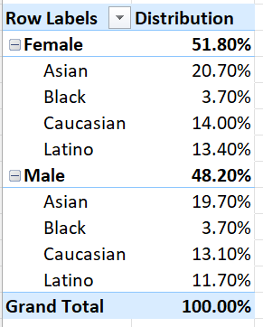
Que1:Gender and Ethnicity Distribution
Distribution is shown

Slide 3
Que 2

Slide 4
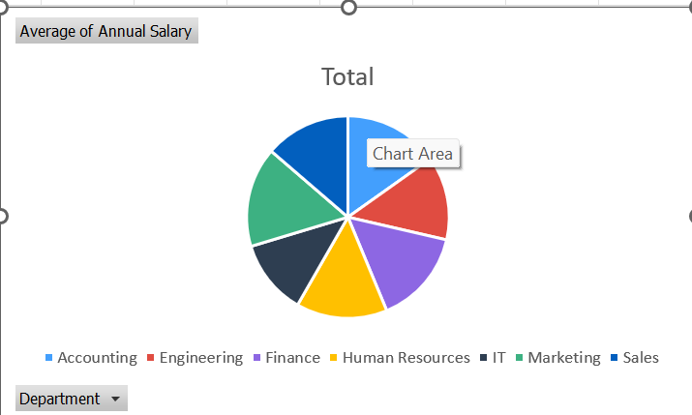
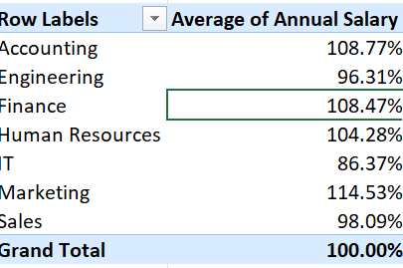
Que3
There is not major differences in average salaries of different department.

Slide 5
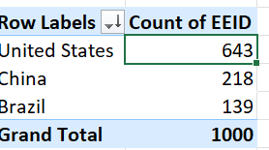
Que 4
United States is having highest no. of employees.

Slide 6
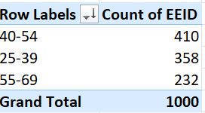
Que 5
Most common age range among the employees is 40 to 54 .

Slide 7

Que 6
Average bonus given is 9%.

Slide 8
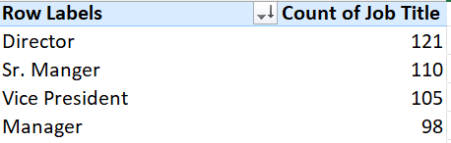
Que 7
It is Director.

Slide 9
Que 8

Slide 10
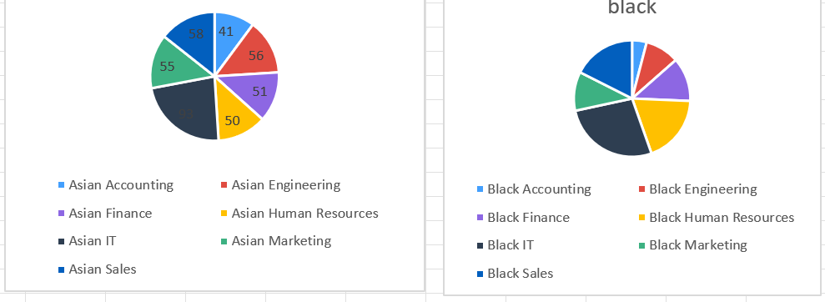
Que 9
Black have more diversity in ethnicity.

